Slide 1
BVNDH – Revit Custom Apps
View Apps

Slide 2
Project Stages
Deliverables
DA
SD
DD

Slide 3
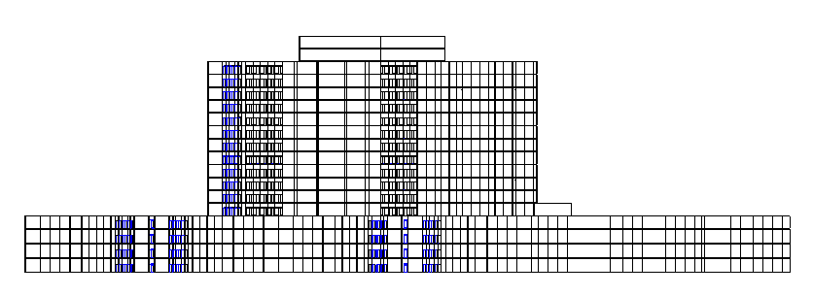
Sample Project
18 Storey's
4 Packages

